Slide 1
Driveby attack
07/20/20XX

Slide 2
AGENDA SLIDE
WRITE YOUR SUBTITLE HERE
01
02
03
04
05
Concept ,
Definition
&
Scope
Goals
&
Benefits
Outcome
Architecture
&
Process Flows
Solution Package
&
Validation
Lesson Learned
.

Slide 3
Concept ,Definition
&
Scope
Summary of PoC
Business Opportunities
Confidential
01
Problem Statement
As the number of websites in the world grows, so do the chances of having vulnerable websites. Attackers use this to perform drive-by attacks. There are antiviruses which can detect them, but they cannot handle new techniques which attackers use as their methods are based on heuristics. Thus, we need a method that can detect new attacks in real time.
Scope
Detect malicious content contained in javascript.
.
Business opportunities for technology
Organizations can use this to detect/stop drive-by attacks which can have a huge impact on their organization
Individuals can also use this to stop drive-by attacks
Out of Scope
Detecting malicious content in php is out of scope.
Detecting malicious content in python is out of scope.

Slide 4
Estimated Schedule
YOUR SUBTITLE HERE
 | TASK NAME | Week1 |  |  |  |  |  |  | Week2 |  |  |  |  |  |  | Week3
 |  | M | T | W | T | F | S | S | M | T | W | T | F | S | S | M | T | W | T | F | S | S
1 | Web scaping good and bad website links
2 | Write a script to perform web scraping of javascript content from a website
3 | Feature extraction
4 | EDA
5 | ML model building and performance evaluation
6 | Results interpretation
7

Slide 5
Actual Schedule
YOUR SUBTITLE HERE
 | TASK NAME | Week1 |  |  |  |  |  |  | Week2 |  |  |  |  |  |  | Week3
 |  | M | T | W | T | F | S | S | M | T | W | T | F | S | S | M | T | W | T | F | S | S
1 | Web scaping good and bad website links
2 | Write a script to perform web scraping of javascript content from a website
3 | Feature extraction
4 | EDA
5 | ML model building and performance evaluation
6 | Results interpretation
7

Slide 6
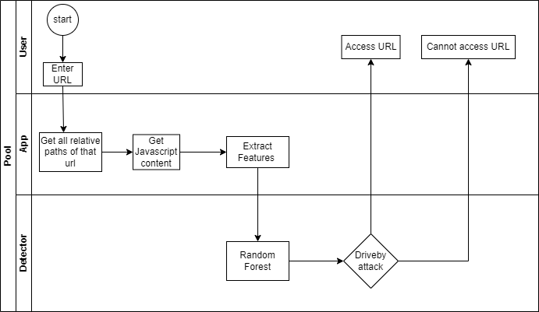
Flow Diagram

Slide 7
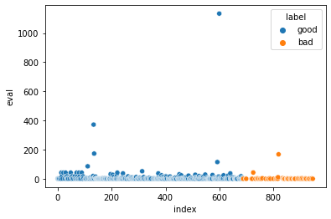
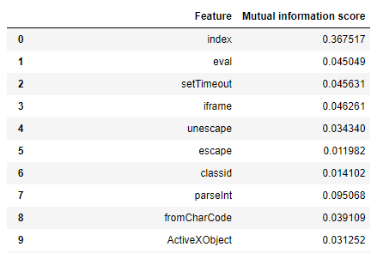
Analysis and Interpretation
.
The index( indexOf() function) feature has the highest mutual information score of 0.367517 compared to the other features.
It can be combined with one other feature(mostly the javascript functions) to correctly classify the URLS
Random Forest has the highest accuracy score of 99.8%, when using index and eval features
The accuracy is higher when compared to Random Forest when using all the features, this shows that some noise was removed

Slide 8
JOURNEY MAP
WRITE YOUR SUBTITLE HERE
PLANNING
COMMUNICATION
EXECUTION
IMPLEMENTATION
WORKING ON
FEEDBACK
Feature Extraction
PAIN
POINTS
Decide on the ML approach to follow
TOUCHPOINTS
EMOTIONS
Study the techniques which are currently being used
POSSIBLE
SOLUTION
.
ACTION
Follow the approach which extracts features from JavaScript
Extract Features from JavaScript content

Slide 9
GOALS THE POC AIMS TOACHIEVE
What achievable goals
we are targeting
Analysis of results
Model Implementation
Q2
Q1
Get good and bad website links
Q4
Feature Extractor
.
Q3

Slide 10
Plan Vs Actual
Key points of originally decided Vs changed
Original Plan
Actuals
Web scraping good and bad website links
Took datasets from kaggle
Write a script to perform web scraping of javascript content from a website
Write a script to perform web scraping of javascript content from a website
Feature extraction
Feature extraction
EDA, ML model building and performance evaluation
EDA, ML model building and performance evaluation
Results interpretation
Results interpretation

Slide 11
Deployment details
As a service (Website)
Have website endpoint which will connect to our model
The user must copy the URL of the website he/she wants to visit, then the results will be whether the website is safe or not
.

Slide 12
Lessons learned
The malicious script is usually hidden within the webpages
Most of the malicious websites contain indexOf() and eval() functions, which are in turn the most influential combination in the classification process
The lexical analyzer(slimit package in python) cannot handle the html content within javascript
.

Slide 13
Packages to install
Beautiful soup( to be able to read the html content)
pip3 install beatifulsoup4
Slimit (lexical analyzer)
pip3 install slimit
.

